Slide 1


Session 1 (DAY 1) Statistical and Machine Learning Models Workshop on Quantitative Literacy and Statistics

Slide 2
Statistical Learning
Supervised Learning
Unsupervised Learning
Regression
Classification

Slide 3
Session 2: Part 1 Supervised Learning Workshop on Quantitative Literacy and Statistics

Slide 4

Supervised Learning
Data
Prediction
Model

Slide 5

Supervised Learning
Learning techniques to find a function to predict a response variable (Y) from set of independent variables (X)
Independent/Predictor Variable
X
Dependent/Response
Variable
Y
Predict
$$Y=f\left(x\right)$$

Slide 6



Supervised Learning: Regression
Predict Continuous Response (Y) from set of Independent Variables (X)
Weight
MPG
$$MPG=f\left(Weight\right)$$

Slide 7


Supervised Learning: Classification
Predict a Categorical Response Variable from a set of Independent Variables
Cholesterol Level
Get a Heart Disease or Not
$${\text{Heart} \text{Disease}}_{(Yes or No)} =f\left(\text{Cholesterol} \text{Level}\right)$$

Slide 8
Supervised Learning
1. Linear Models
Regression : Linear Regression
Classification : Logistic Regression
2. Bagging Methods
Regression : Random Forest Regression
Classification : Random Forest Classification
3. Boosting Methods
Regression : Gradient Boost Regression
Classification : Gradient Boost Classification

Slide 9
1. Linear Models

Slide 10
Regression
Linear Regression

Slide 11





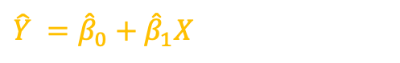



Y - Response
$$\hat{Y} ={\hat{β}}_{0}+{\hat{β}}_{1}X$$
X | Y
$$x_{1}$$ | $$y_{1}$$
$$x_{2}$$ | $$y_{2}$$
$$x_{3}$$ | $$y_{3}$$
$$x_{4}$$ | $$y_{4}$$
$$x_{5}$$ | $$y_{5}$$
$\hat{Y}$ - Prediction
$$e_{5}$$
$$e_{4}$$
$$e_{2}$$
$$e_{3}$$
$$e_{1}$$
X - Predictor
Simple Linear Regression Model: $Y =β_{0}+β_{1}X+Error$
$β_{0}$ - Response when X = 0
$β_{1}$ - Increase of Response when X increase by 1-unit

Slide 12




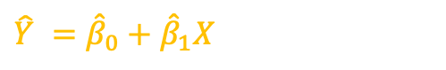



Y - Response
$$\hat{Y} ={\hat{β}}_{0}+{\hat{β}}_{1}X$$
$\hat{Y}$ - Prediction
$$e_{5}$$
Residual: $e_{i}=y_{i}−\hat{y_{i}}$
$$e_{4}$$
Residual Sum of Square: RSS = $e_{1}^{2}$+ $e_{2}^{2}$+ $e_{3}^{2}$+ $e_{4}^{2}$+ $e_{5}^{2}$
$$e_{2}$$
$$e_{3}$$
RSS = $\sum{{\left(Y −\hat{Y}\right)}^{2}}$
Find $β_{0}$ and $β_{1}$ which minimize the RSS
$$e_{1}$$
X - Predictor

Slide 13
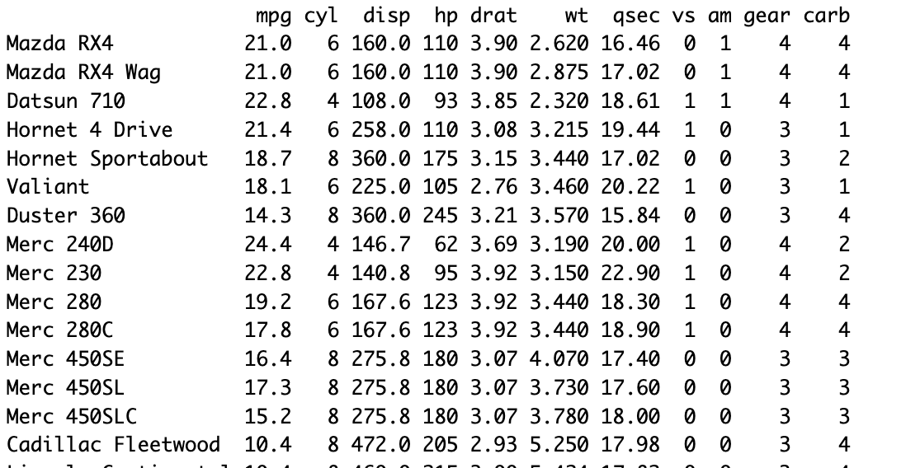

Weight
MPG
$$\hat{MPG} ={\hat{β}}_{0}+{\hat{β}}_{1}Weight$$

Slide 14
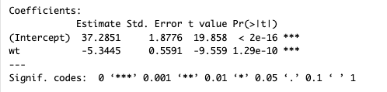



Weight
MPG
$$\hat{MPG} ={\hat{β}}_{0}+{\hat{β}}_{1}Weight$$
lm(formula = mpg ~ wt ,data = mtcars)
$${\hat{β}}_{0}=37.28$$
$${\hat{β}}_{1}=−5.34$$
$$\hat{mpg}=37.28−5.34 Weight$$
p-value will provide statistical significance
$β_{1}−Weight$ is a significant variable in estimating MPG

Slide 15
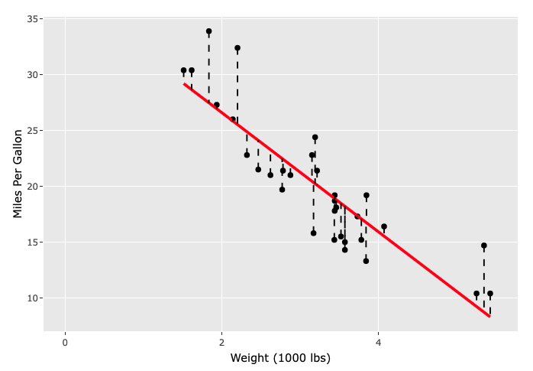

$$\hat{mpg}=37.28−5.34 Weight$$

Slide 16
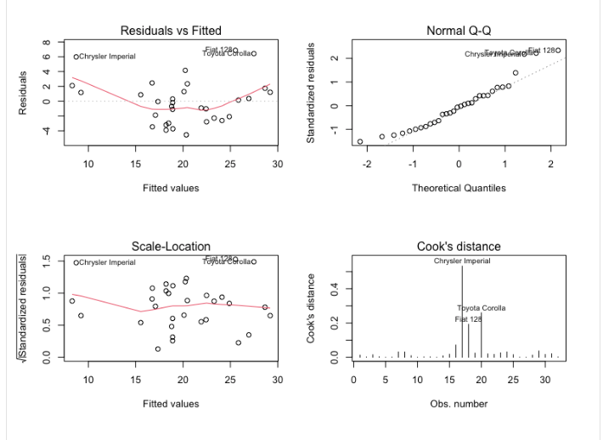
Linear Regression Assumptions
Assumptions
Linearity of Data
Independence of Errors
Constant Variance of residuals
Normality of Residuals
No Multicollinearity

Slide 17
Linear Regression Assumptions
Assumptions
Linearity of Data
Transform X variables
Independence of Errors
Use Autoregressive Models
Constant Variance of residuals
Transform dependent variable
Normality of Residuals
Remove/impute outliers
Transform dependent variables
No Multicollinearity
Remove or combine highly correlated X variables
Use Principal component analysis

Slide 18
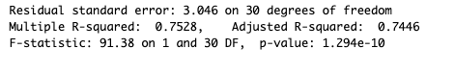

Linear Regression: Evaluation Model Performance
$R^{2}$ - Coefficient of Determination = 0.75
How much variability of response is explained by the predictor variables
${0≤R}^{2}≤1$
Higher the better
Adjusted $R^{2}$ = 0.74
Panelize for additional predictor variables
${ R}_{adj}^{2}≤1$
Higher the better
RMSE – Root mean squared error = 3.04
Lower the Better

Slide 19
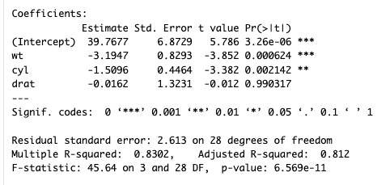
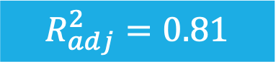

Multiple Linear Regression
$$MPG=β_{0} +β_{1} Weight +β_{2} Cylinders +β_{3} Rear_axle_Ratio + Error$$
multiple_linear_regression = lm(formula = mpg ~ wt + cyl + drat ,data = mtcars)
summary(multiple_linear_regression)
$$R^{2}=0.83$$
$$R_{adj}^{2}=0.81$$
$$\hat{MPG}=39.76 −3.19 Weight −1.51 Cylinders −0.016 Rear_axle_Ratio$$

Slide 20
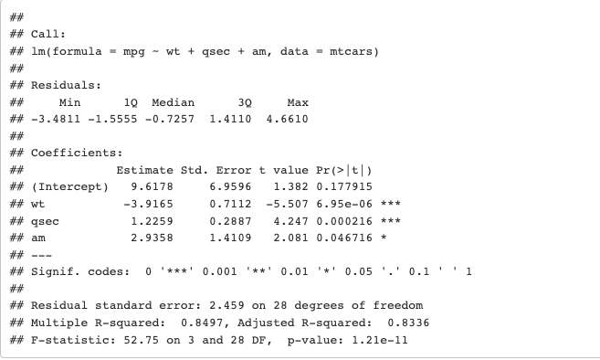
Model Selection: Multiple Linear Regression
Backward Elimination
This method starts with the full model and eliminates unimportant predictor variables from the model.
library(MASS)
full_model_linear_regression = lm(formula = mpg ~ . ,data = mtcars)
backward_model = stepAIC(full_model_linear_regression, direction = "backward", trace = FALSE)
summary(backward_model)
$$\hat{MPG}=9.61 −3.91 Weight+1.22 qsec −2.93 Transmission$$

Slide 21
Model Selection: Multiple Linear Regression
Stepwise Method
Systematically add and remove predictor variables from the model.
library(MASS)
full_model_linear_regression = lm(formula = mpg ~ . ,data = mtcars)
stepwise_model = stepAIC(full_model_linear_regression, direction = "both", trace = FALSE)
summary(stepwise_model)
$$\hat{MPG}=9.61 −3.91 Weight+1.22 qsec −2.93 Transmission$$

Slide 22
Classification
Logistic Regression

Slide 23
Cholesterol
Age
No Heart Disease
Hear Disease

Slide 24
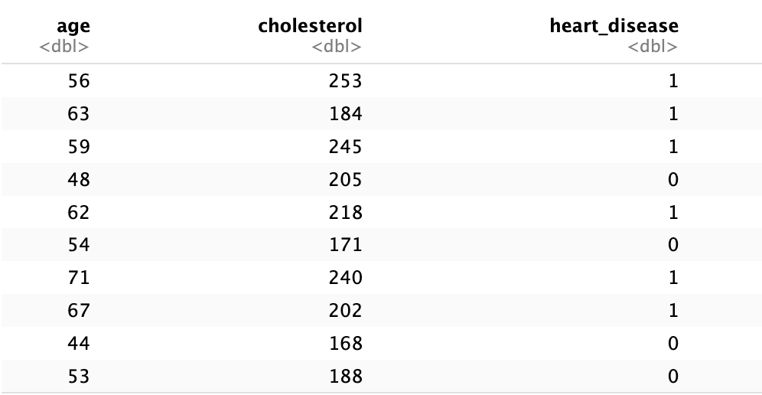
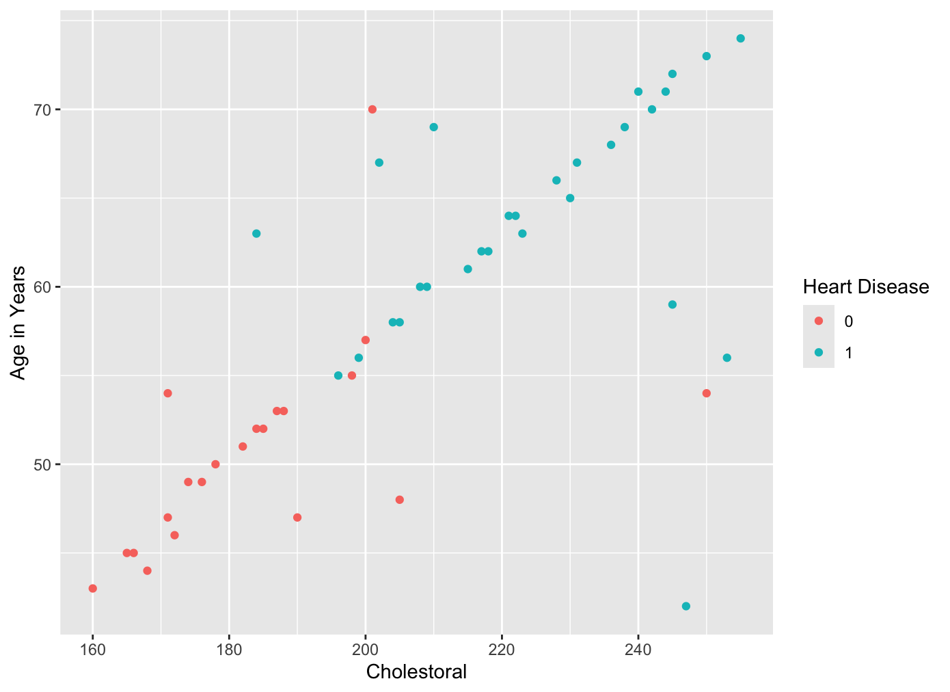
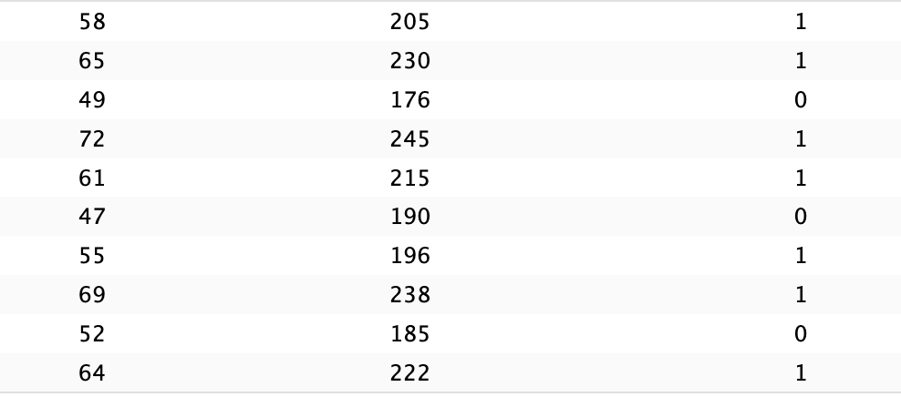
50 Subjects
And more ….

Slide 25

Cholesterol Level
Get a Heart Disease or Not
$p$ – Probability of Getting a Heart Disease
$$Log \left[\frac{p}{1−p}\right]=β_{0}+β_{1}Cholesterol$$

Slide 26
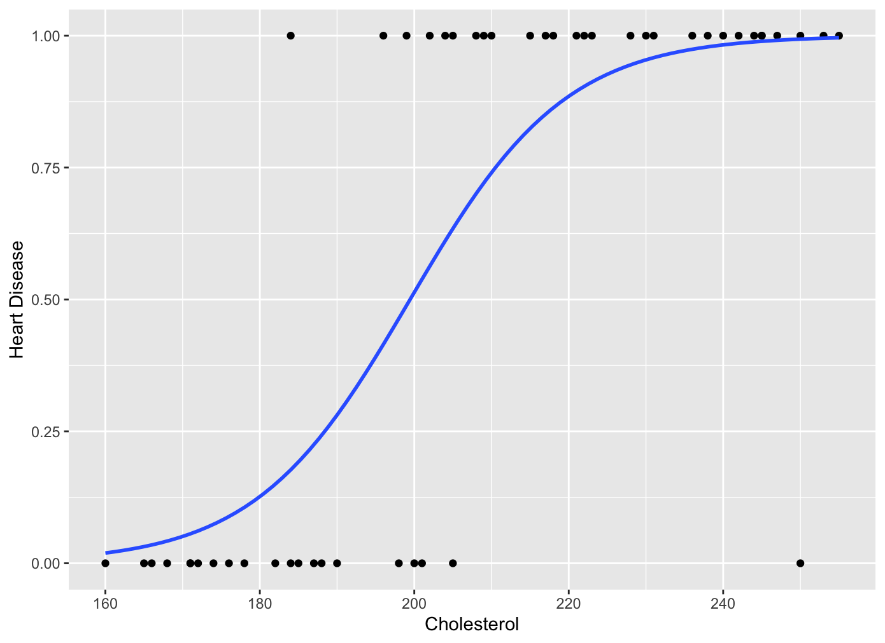

$$p\left(x\right)=\frac{exp(x)}{1+exp(x)}$$

Slide 27
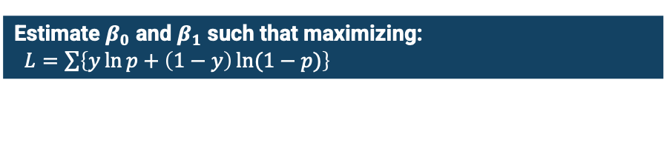
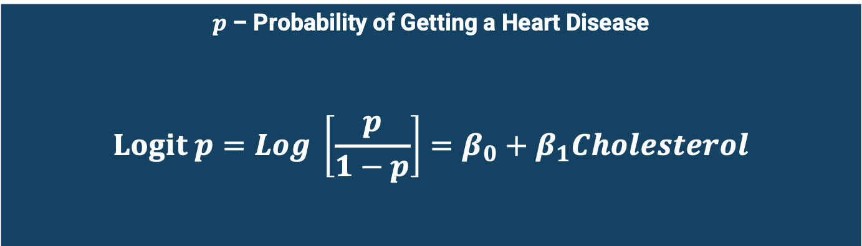
$p$ – Probability of Getting a Heart Disease
$$Logit p=Log \left[\frac{p}{1−p}\right]=β_{0}+β_{1}Cholesterol$$
Estimate $β_{0}$ and $β_{1}$ such that maximizing:
$L=\sum{\left\{y\ln{p}+\left(1−y\right)\ln{(1−p)}\right\}}$

Slide 28

$p$ – Probability of Getting a Heart Disease
$$Logit \{p\}=β_{0}+β_{1}Cholesterol$$
$$Logit p=Log \left[\frac{p}{1−p}\right]=β_{0}+β_{1}Cholesterol$$
This is also equivalent to:
$$p= \frac{exp(β_{0}+β_{1}Cholesterol)}{1+exp(β_{0}+β_{1}Cholesterol)}$$

Slide 29
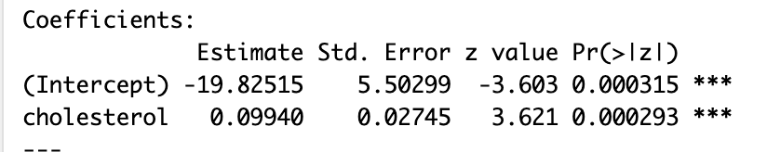


logistic_regression = glm(formula = heart_disease ~ cholesterol,
data = loan_df,family = 'binomial’)
summary(logistic_regression)
$$logit \left(\hat{p}\right)=−19.82+0.099 \text{Cholesterol}$$
$$\hat{p}=\frac{\exp{(−19.82+0.099 \text{Cholesterol})}}{1+\exp\left(−19.82+0.099 \text{Cholesterol}\right)}$$
$\hat{p}$ - Probability of getting a heart disease given the Cholesterol Level
If $p>0.5 →\text{H}\text{eart} \text{D}\text{isease}$
We can change 0.5 to a different probability threshold.

Slide 30
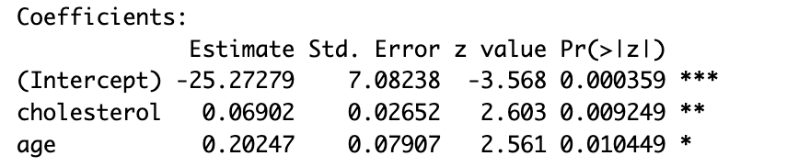

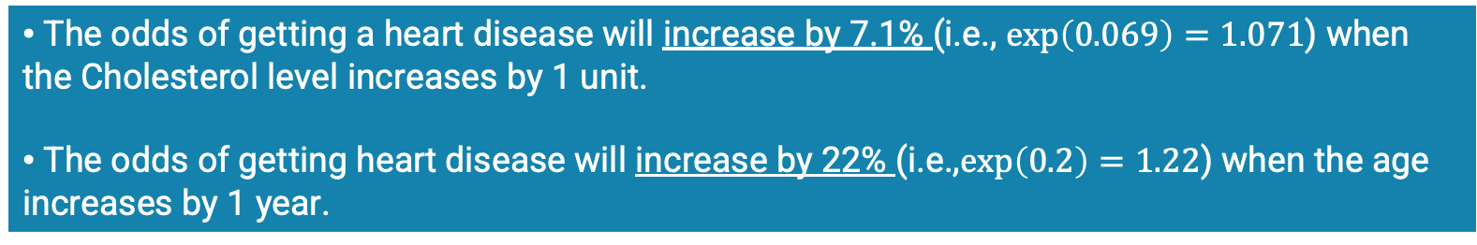
logistic_regression = glm(formula = heart_disease ~ cholesterol + age ,
data = heart_df, family = 'binomial')
summary(logistic_regression)
$$logit \left(\hat{p}\right)=−25.3+0.069 Cholesterol+0.2 Age$$
$$\hat{p}=\frac{\exp{(−25.3+0.069 Cholesterol+0.2 Age)}}{1+\exp\left(−25.3+0.069 Cholesterol+0.2 Age\right)}$$
$\hat{p}$ - Probability of approving the loan when income and age is known
The odds of getting a heart disease will increase by 7.1% (i.e., $exp\left(0.069\right)=1.071$) when the Cholesterol level increases by 1 unit.
The odds of getting heart disease will increase by 22% (i.e.,$exp\left(0.2\right)=1.22$) when the age increases by 1 year.

Slide 31
2. Bagging Methods

Slide 32
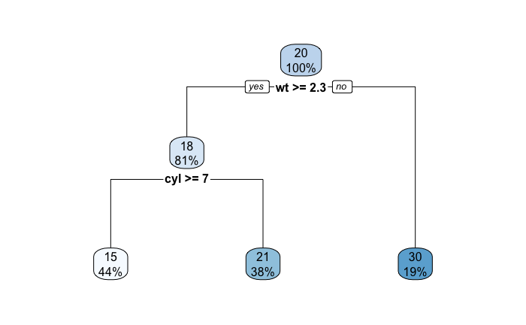
Regression Trees (Decision Trees)
Partition the data set into decision boundaries.

Slide 33
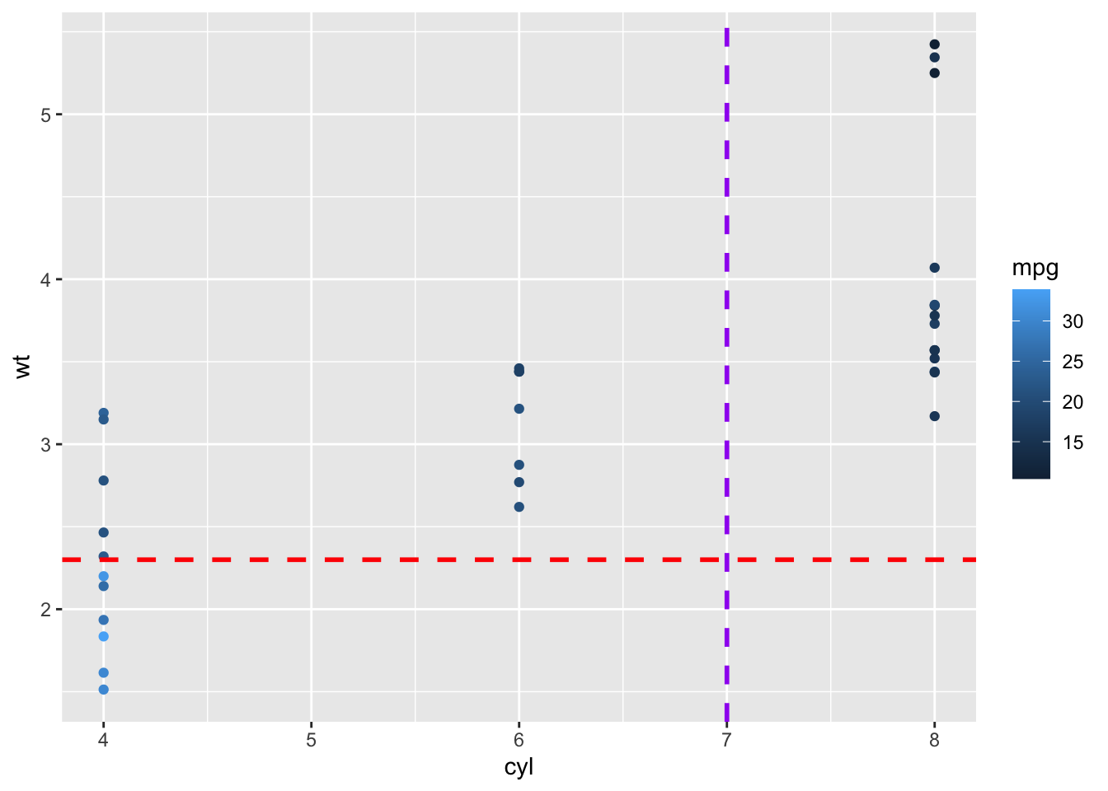

Slide 34
Regression
Random Forest Regression

Slide 35
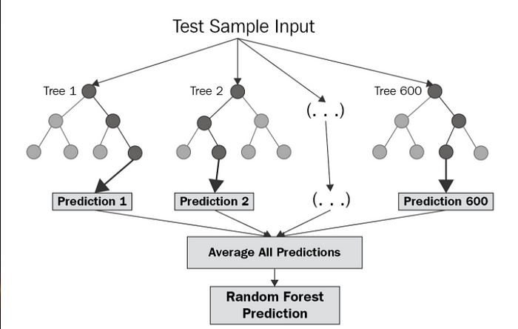
Random Forest Regression use the “Bagging” Technique
Source: https://levelup.gitconnected.com/random-forest-regression-209c0f354c84

Slide 36
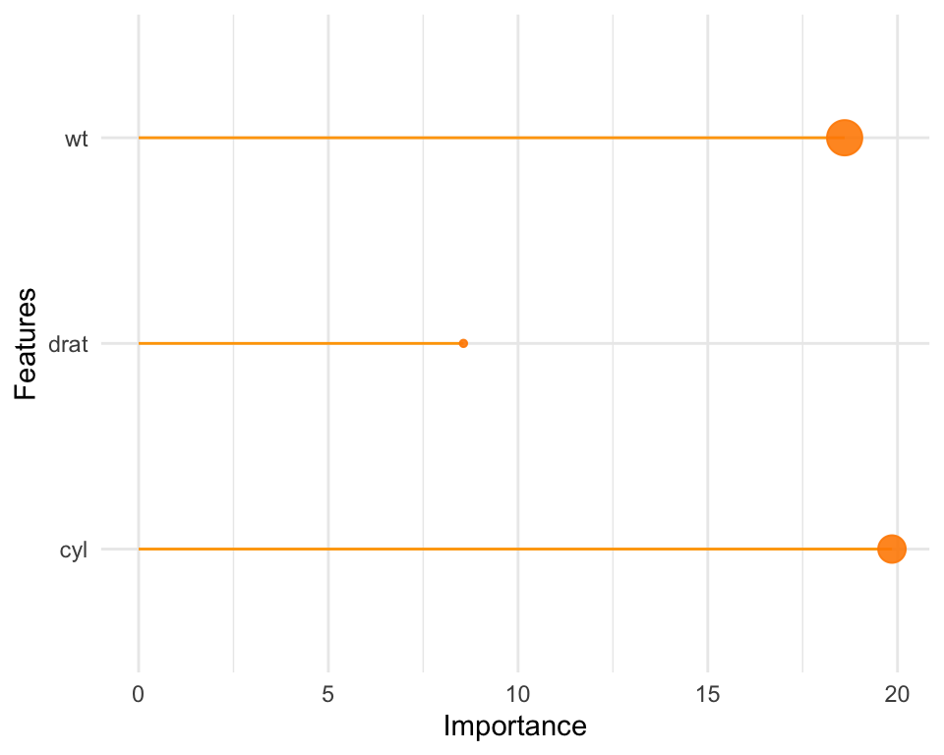
library(randomForest)
Random_Forest_model = randomForest(formula = mpg ~ wt + cyl + drat,
data = mtcars,
ntree=500, importance=TRUE)

Slide 37
Comparison of Linear Regression and Random Forest
Linear Models | Bagging Methods Forest
Linear Model Works well when data is linear | Non-linear Model Work well with both linear and nonlinear data Ensemble Technique Take the average prediction of multiple models
Multicollinearity exists Model parameter estimates will not be accurate when there is a significant relationship between input variables (features) | Multicollinearity is not an issue
Model Interpretation A better interpretation of variables | Model Interpretation is moderate Not best as linear regression
Multicollinearity – Input (predictor) variables are significantly correlated

Slide 38
Classification
Random Forest Classification

Slide 39
Random Forest Classification
Take the Majority Vote
Source: https://levelup.gitconnected.com/random-forest-regression-209c0f354c84

Slide 40
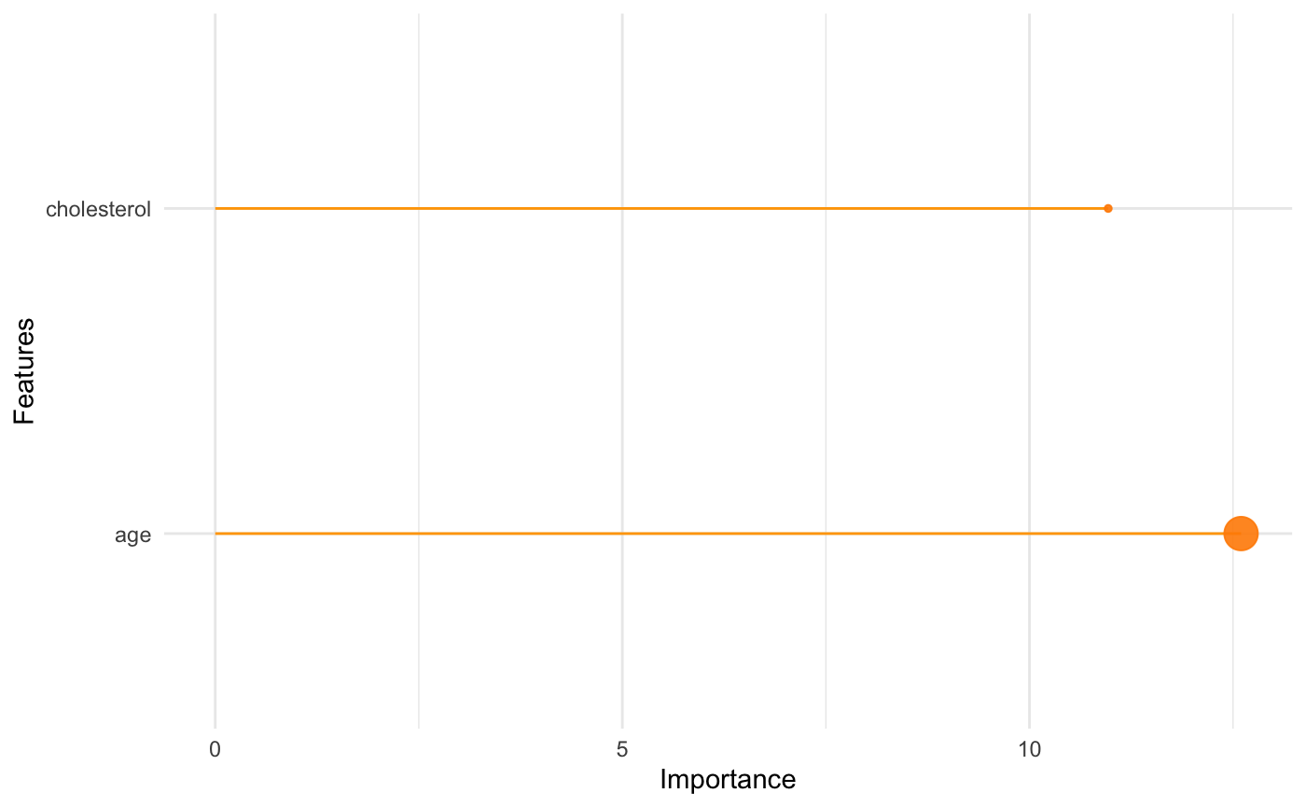
library(randomForest)
Random_Forest_Classifier = randomForest(as.factor(heart_disease) ~ cholesterol + age, data=heart_df, importance = TRUE, ntree=500)

Slide 41
Comparison of Logistic Regression and Random Forest
Logistic Regression | Random Forest Classification
Linear Model Works well when data is linear | Non-linear Model Work well with both linear and nonlinear data Ensemble Technique Take the average prediction of multiple models
Works with two classes - Multinomial logistic regression shall be used to for than 2 classes | Can extend for multiple classes
Model Interpretation A better interpretation of variables | Model Interpretation is moderate Not best as the logistic regression

Slide 42
3. Boosting Methods

Slide 43
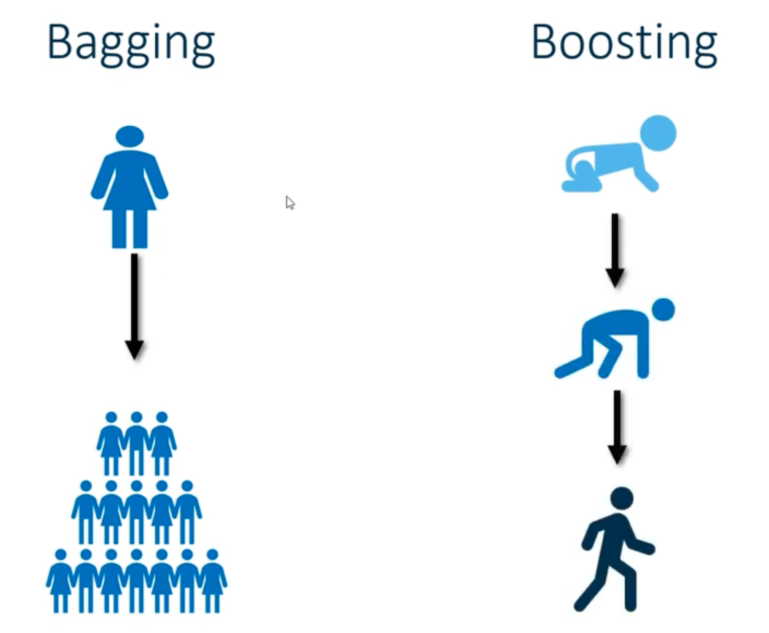
Trees are built in parallel
Trees are built in sequentially
Source: SAS.com

Slide 44
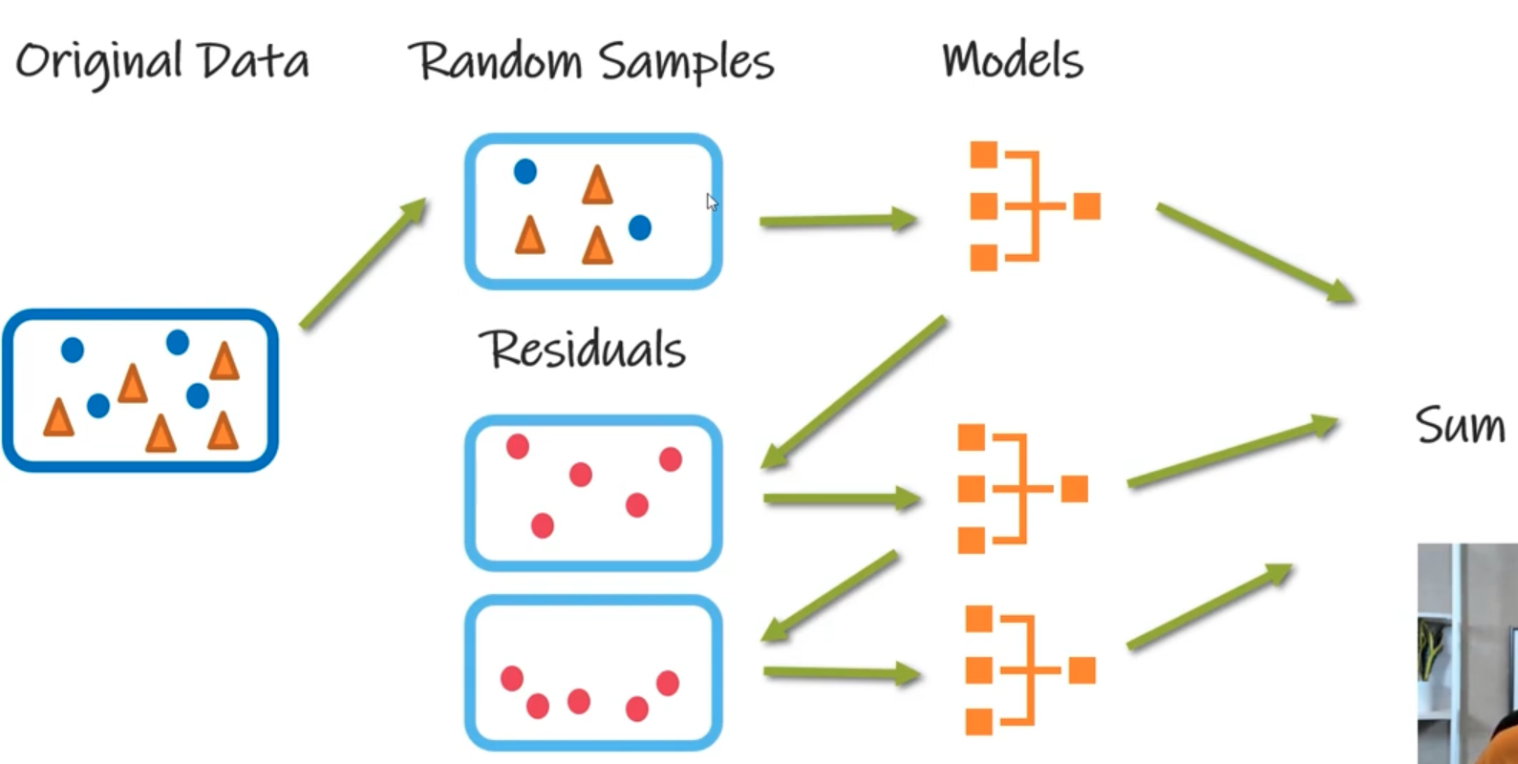
Source: SAS.com

Slide 45
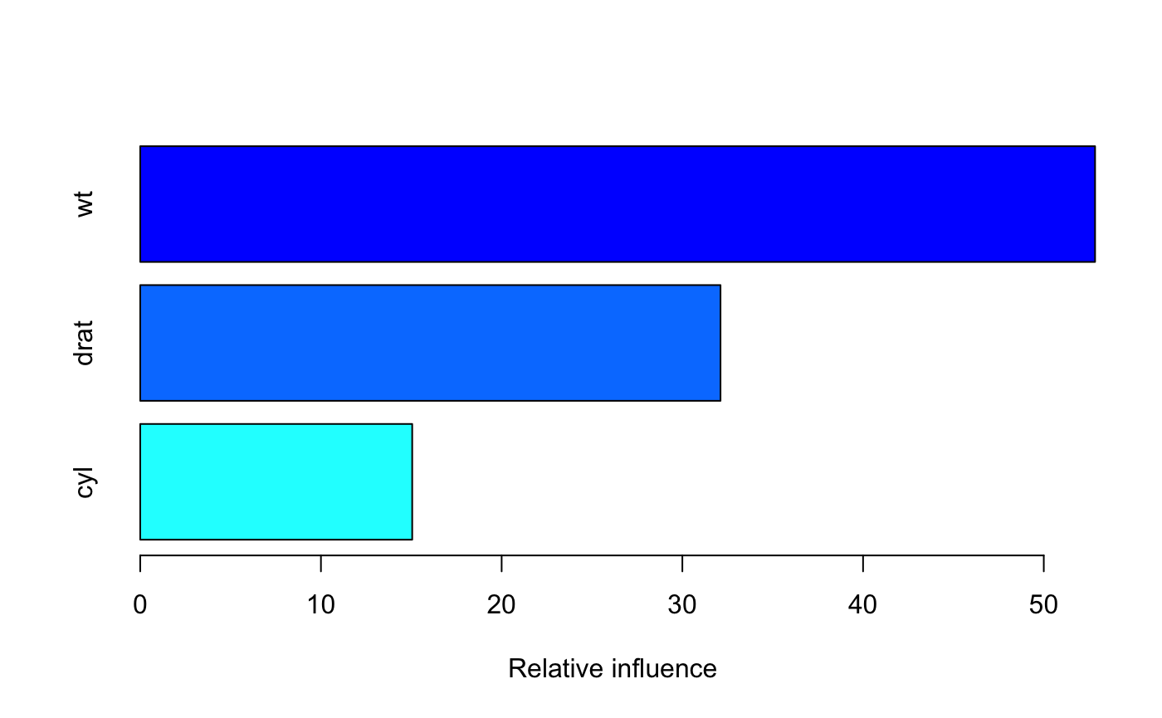
Gradient Boost Regression
library(gbm)
Gradient_Boost_Regression = gbm(formula = mpg ~ wt + cyl + drat,
data = mtcars, n.trees = 2000,
n.minobsinnode = 5
)

Slide 46
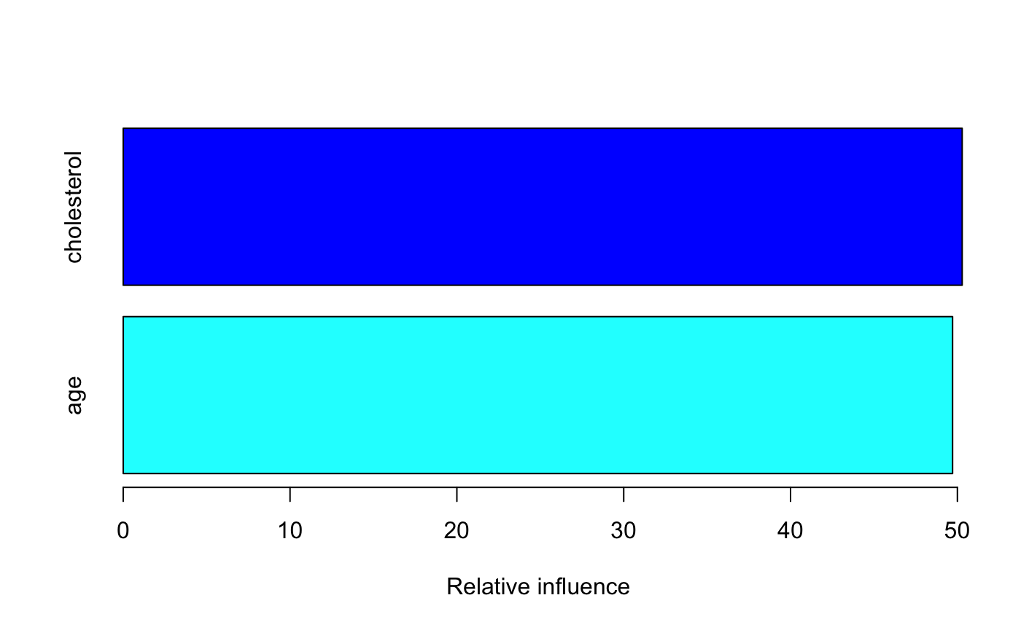
Gradient Boost Classification
library(gbm)
Gradient_Boost_Classifier = gbm(heart_disease ~ cholesterol + age,
data=heart_df,
n.trees = 2000)

Slide 47
Performance Metrices in Supervised Learning

Slide 48

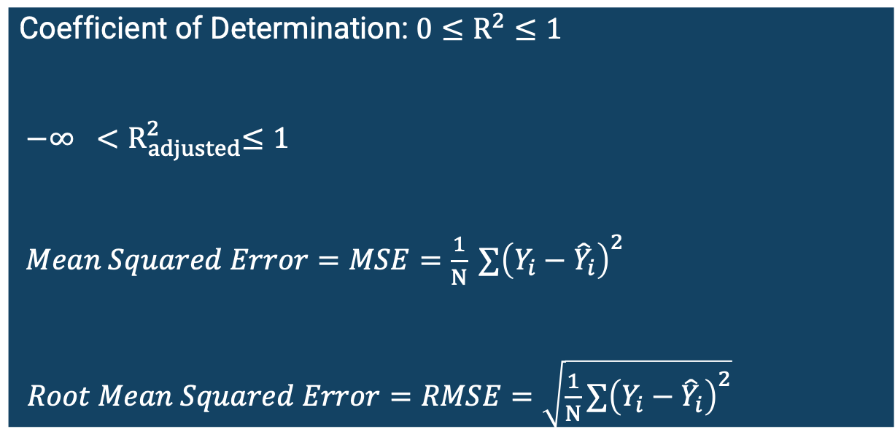
Evaluate Model Performance in Regression
Coefficient of Determination: ${0≤R}^{2}≤1$
${−∞ <R}_{adjusted}^{2}≤1$
$Mean Squared Error=MSE=\frac{1}{N} {∑\left(Y_{i}−{\hat{Y}}_{i}\right)}^{2}$
$Root Mean Squared Error=RMSE=\sqrt{\frac{1}{N}∑{\left(Y_{i}−{\hat{Y}}_{i}\right)}^{2}}$
$Y$ – Observed Value
$\hat{Y}$ – Predicted Value
N – Total Number of Observations

Slide 49
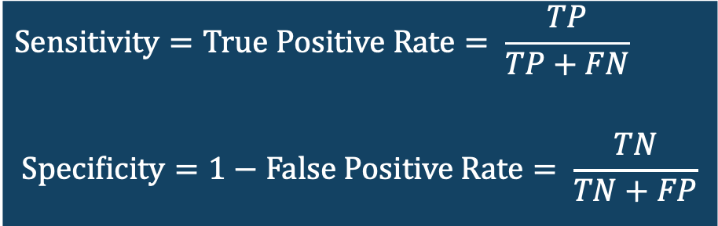
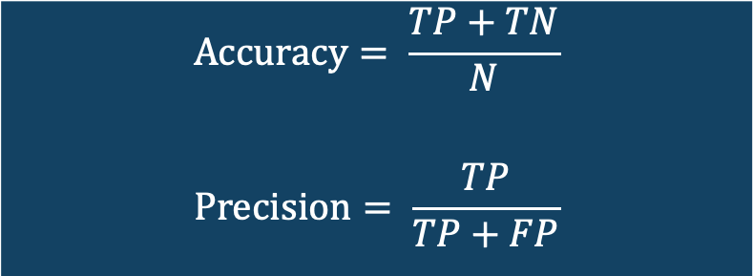
Evaluate Model Performance in Classification
Confusion Matrix
Actual Classes
 | 0 | 1
0 | True Negative | False Negative
1 | False Positive | True Positive
Predicted Classes
$$Accuracy= \frac{TP+TN}{N}$$
$$Precision= \frac{TP}{TP+FP}$$
$$Sensitivity=True Positive Rate= \frac{TP}{TP+FN}$$
$$Specificity=1−False Positive Rate= \frac{TN}{TN+FP}$$
N – Total Number of Observations

Slide 50
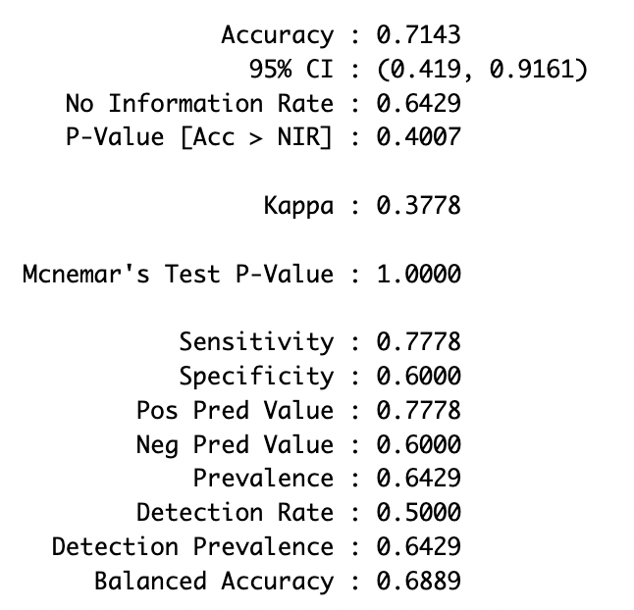
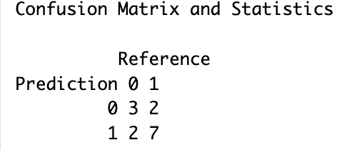
Evaluate Model Performance in Classification
library(caret)
random_forest_prediction = predict(Random_Forest_Classifier)
observed_data = as.factor(heart_df$heart_disease)
confusionMatrix( random_forest_prediction, observed_data, positive = '1')

Slide 51
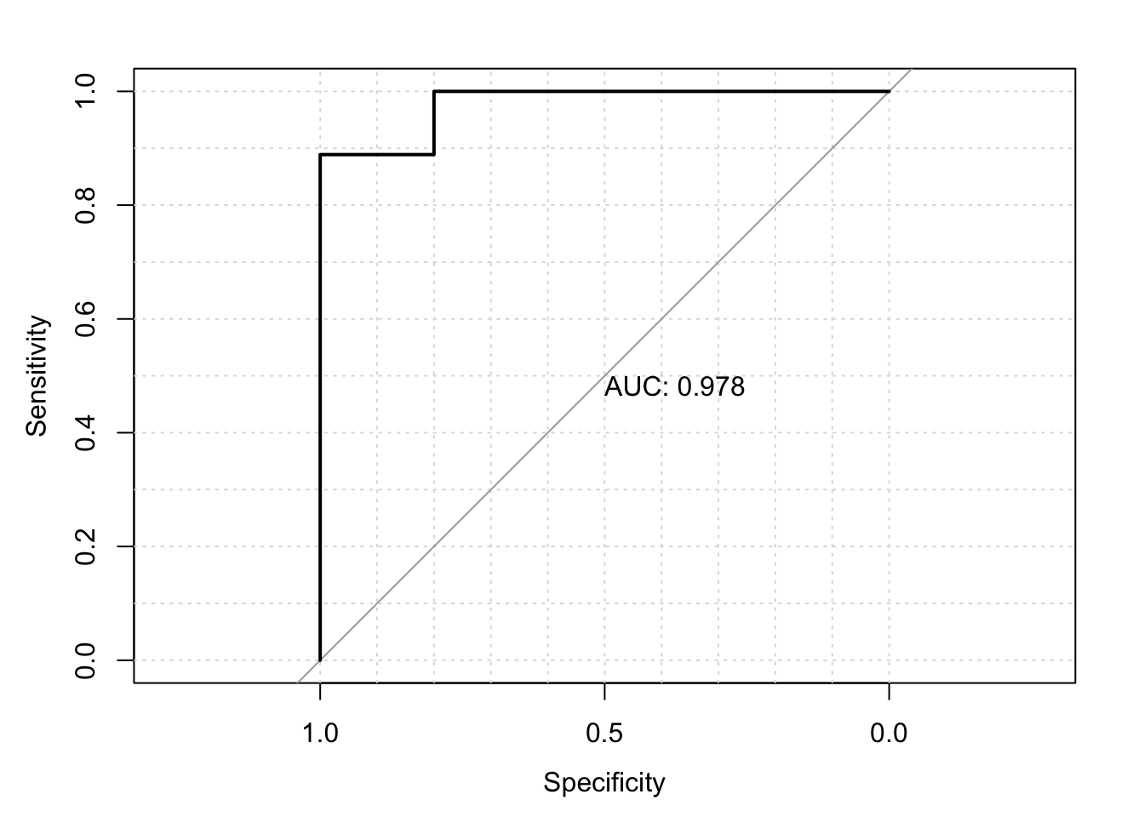
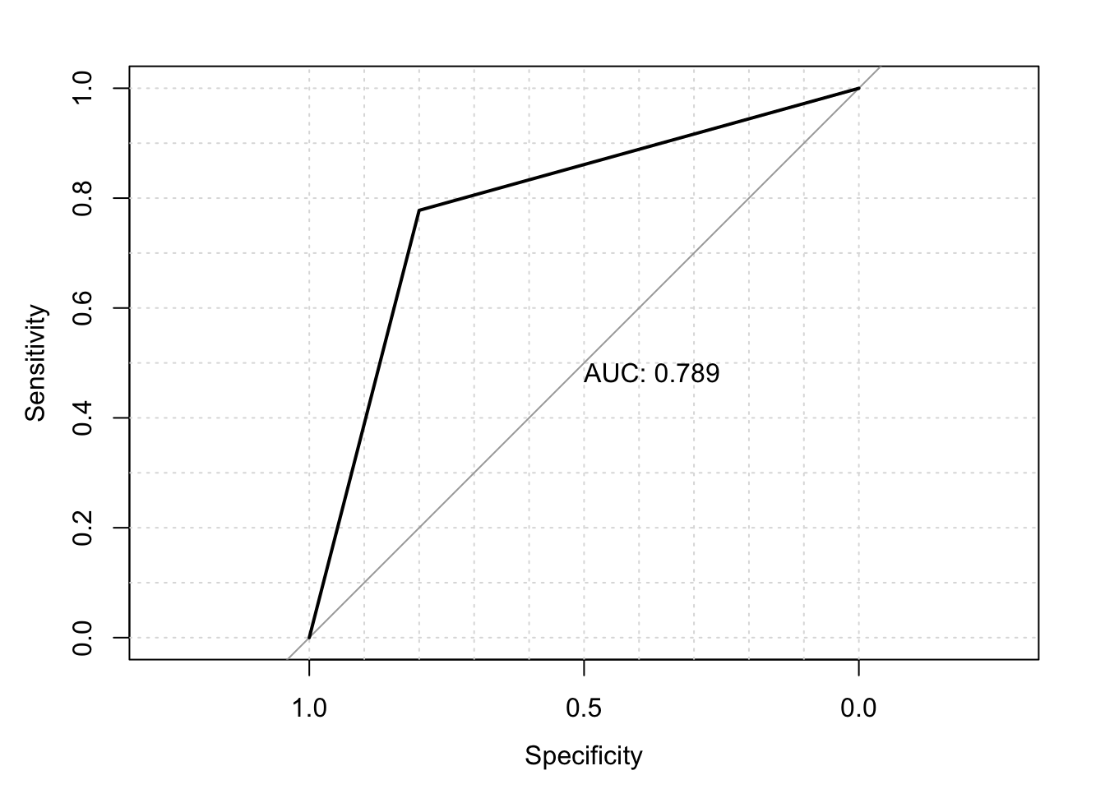

Evaluate Model Performance in Classification
Receiver Operating Characteristic (ROC) Curve
Logistic Regression
Random Forest Classifier
ROC curve is a plot between the Sensitivity and Specificity of a classification model
If the area under the curve is 0.5, we are making random guesses
If the area under the curve is close to 1, we are making accurate predictions
$$Sensitivity= \frac{TP}{TP+FN}$$
$$Specificity= \frac{TN}{TN+FP}$$

Slide 52
Method Type | Examples | Advantages | Disadvantages
Linear Models | Linear Regression Logistic Regression | Easy to interpret Works well for simple, linear patterns | Struggles with nonlinear relationships Sensitive to outliers Requires assumptions (linearity, independence, multicollinearity)
Bagging Methods | Random Forest | Handles nonlinear patterns Robust to noise/outliers | Less interpretable Can be slow for large data
Boosting Methods | Gradient Boosting XGBoost GBM | Handles complex nonlinearities Good for small-to-medium datasets | Can overfit if not tuned Less interpretable Slower training

Slide 53
Overfitting & Cross-Validation

Slide 54
Overfitting in Regression
y
y
y
x
x
x
Underfit
– less complex model
Better Fit
- moderately complex model
Overfit
– high complex model

Slide 55






Overfitting in Classification
$$x_{2}$$
$$x_{2}$$
$$x_{2}$$
$$x_{1}$$
$$x_{1}$$
$$x_{1}$$
Underfit
– less complex model
Better Fit
- moderately complex model
Overfit
– high complex model

Slide 56
How to Overcome Overfitting
Train/Test Data Split
Cross Validation
Regularization

Slide 57
Train/Test Data Split
Training Data
Test Data
All Data Set
Error
Training Error
Test Error
Model Complexity
Error = Actual - Predicted

Slide 58
Regularization
Total Error = Training Error + Regularization
Regularization is proportional to the model complexity and prevents overfitting
Regularization prevents the training error from going to zero
Error
Training Error
Training Error with Regularization
Model Complexity

Slide 59
Cross-validation
K-Fold Cross-Validation
Train Data
Train Data
Train Data
Train Data
Validation Data
All Train Data
Train Data
Train Data
Train Data
Validation Data
Train Data
K-Fold Cross Validation Error
Take average of all Validation Errors
Train Data
Train Data
Validation Data
Train Data
Train Data
Train Data
Validation Data
Train Data
Train Data
Train Data
Validation Data
Train Data
Train Data
Train Data
Train Data

Slide 60
Cross-validation
K-Fold Cross-validation
Error
K-Fold Cross Validation Error
Better Model
Model Complexity

Slide 61


Cross-validation:
Hyperparameter Tuning
Equipment 1 Settings
Equipment 2 Settings

Slide 62
Model 1 Settings
Model 2 Settings

Slide 63
Cross-validation:
Hyperparameter Tuning
Hyperparameters
Model specific parameters which can not be estimated with data
Example: ntrees and mtry in Random Forest
Grid Search
Require to find optimal values with a search
Validation Error
Hyperparameter 2
Optimal Value
Hyperparameter
Hyperparameter 1

Slide 64
Training Data
Use to Train Model
Validation Data
Use to control overfit
Use to tune model parameters
Test Data
Test model with unseen data

Slide 65
Session 1: Part 2 Unsupervised Learning Workshop on Quantitative Literacy and Statistics

Slide 66
Unsupervised Learning
Learning techniques to find a patterns and cluster unlabeled data
Data Set
Cluster 1
Cluster 2
Cluster 3

Slide 67
K-Means Clustering

Slide 68


$$x_{2}$$
Assign data points for the closest centroid
$$x_{1}$$

Slide 69
$$x_{2}$$
Now update the center of the centroids
$$x_{1}$$

Slide 70
$$x_{2}$$
Now update the center of the centroids
$$x_{1}$$

Slide 71
$$x_{2}$$
Find the the closest points and and update the centroid
Repeat the process
$$x_{1}$$

Slide 72
$$x_{2}$$
Find the the closest points and and update the centroid
Repeat the process
$$x_{1}$$

Slide 73
$$x_{2}$$
Find the the closest points and and update the centroid
Repeat the process
$$x_{1}$$

Slide 74
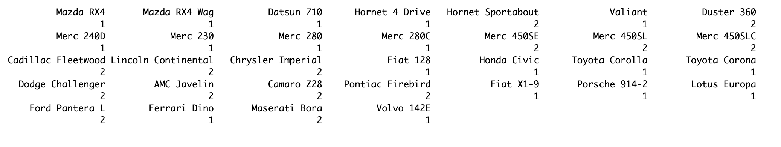
K-Means Clustering
set.seed(123)
k_means_clustering <- kmeans(mtcars, centers = 2)
print(k_means_clustering$cluster)

Slide 75
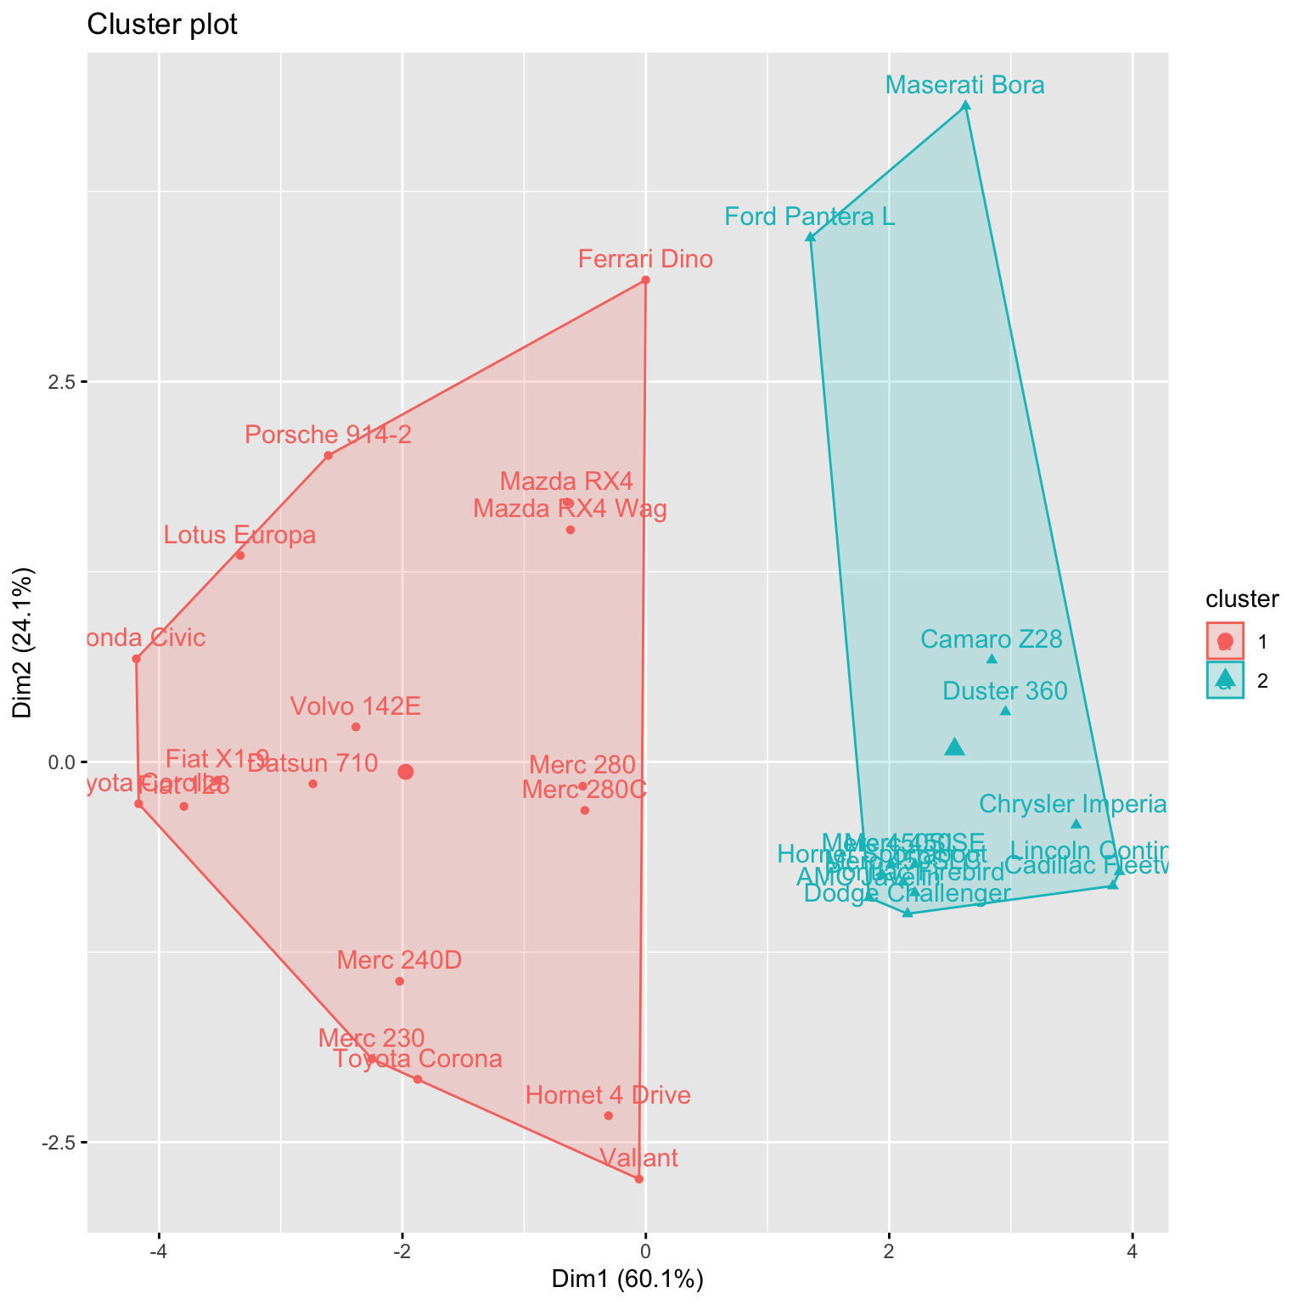
Plot K-Means Clustering
library(factoextra)
fviz_cluster(k_means_clustering, data = mtcars)

Slide 76
Hierarchical Clustering

Slide 77
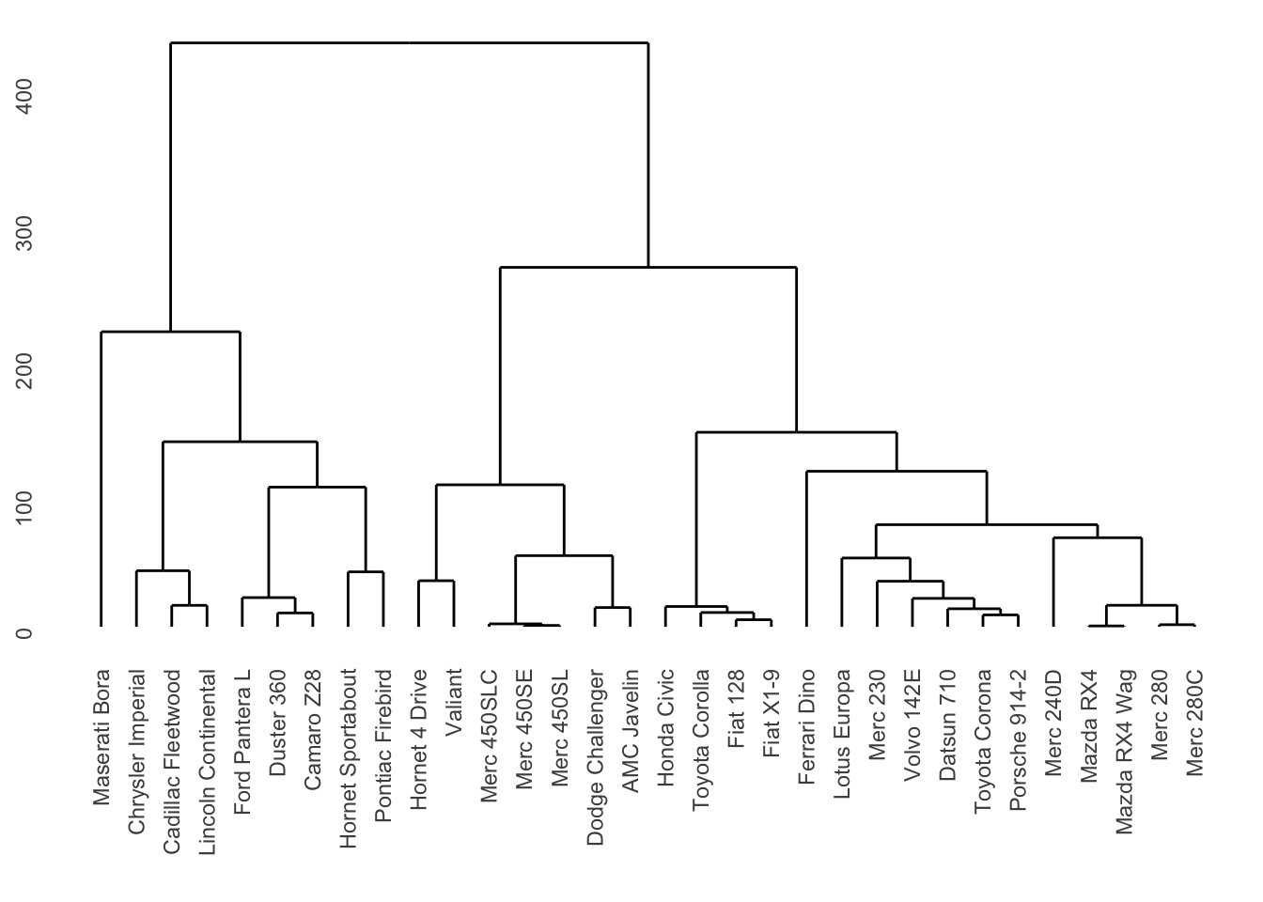
library(ggdendro)
set.seed(123)
mtcars_distance = dist(mtcars, method = 'euclidean')
h_clustering = hclust(mtcars_distance)
ggdendrogram(h_clustering)

Slide 78
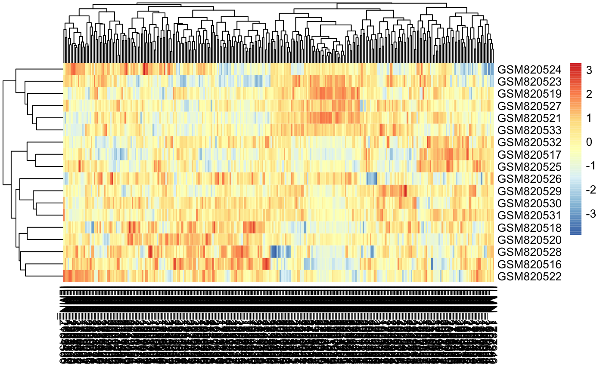
Hierarchical-Means Clustering based heatmaps are popular in analyzing gene expression data

Slide 79
Principal Component Analysis Biplot

Slide 80
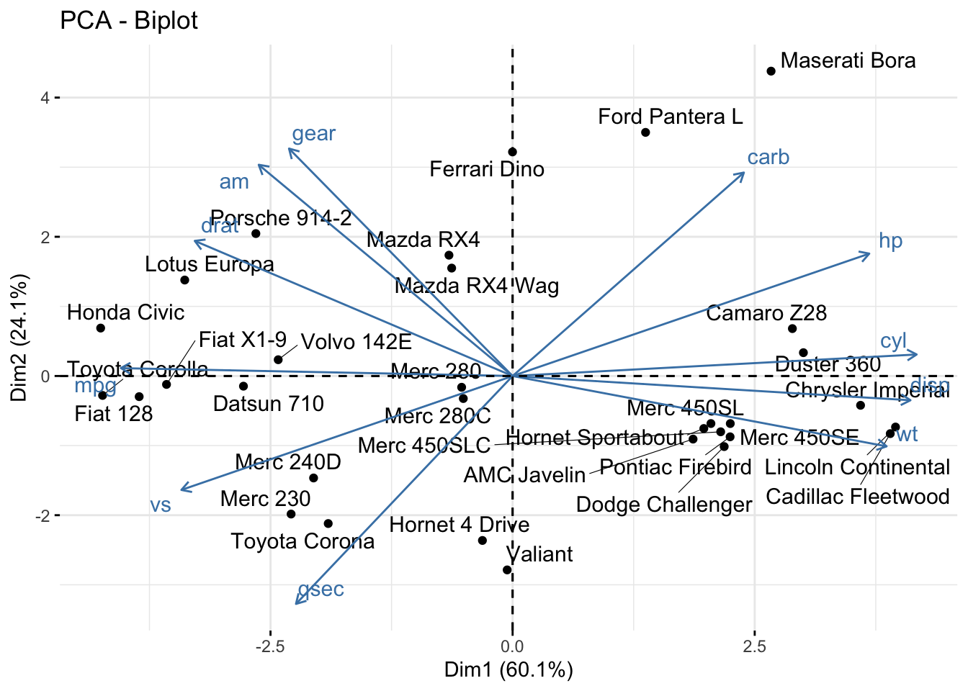
library(FactoMineR)
pca_mtcars <- PCA(mtcars, graph = FALSE)
fviz_pca_biplot(pca_mtcars, repel = TRUE)
PCA Biplot can be used to understand the correlation structure of the variables

Slide 81
Statistical Learning
Supervised Learning
Unsupervised Learning
Regression
Classification
Thank you!

